Slide 1


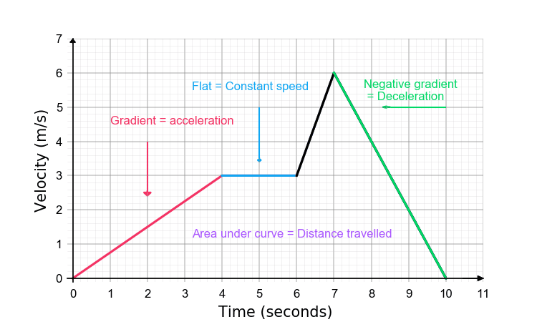

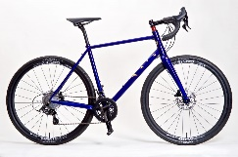
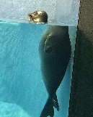
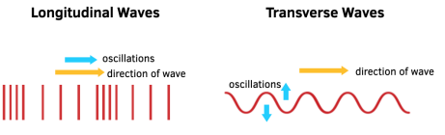
























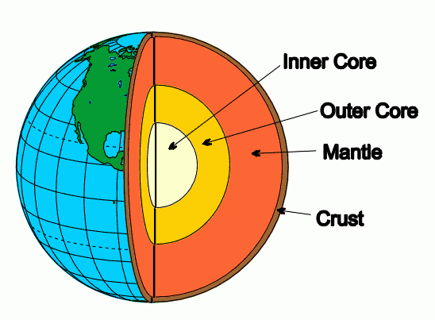




















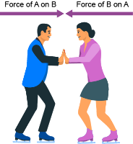
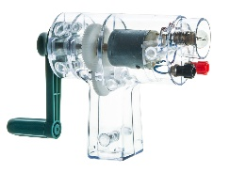

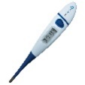
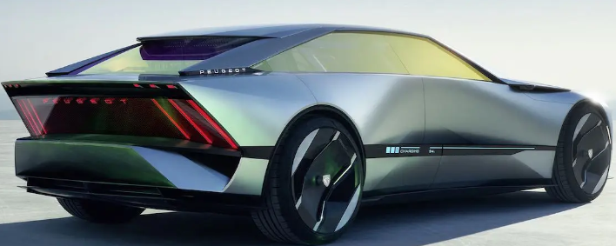
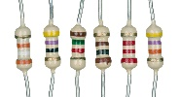

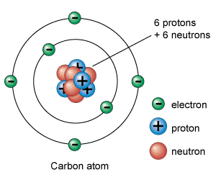



















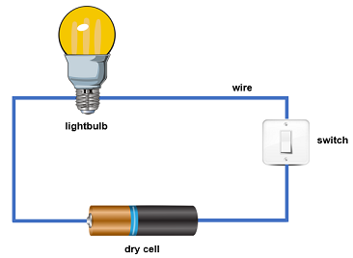
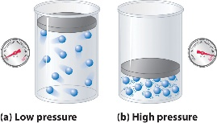
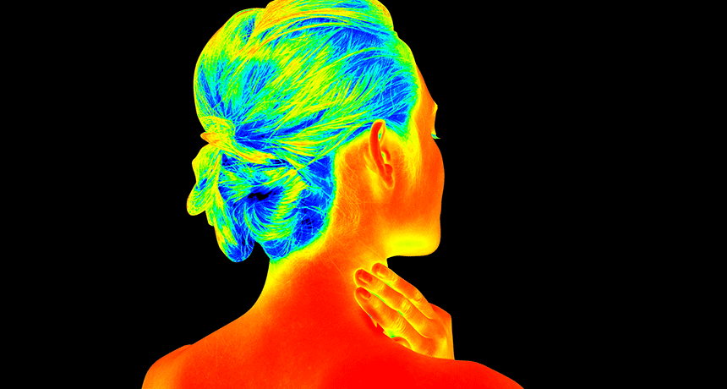
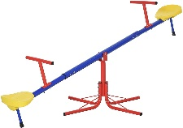










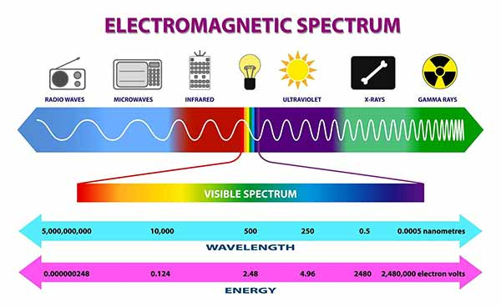
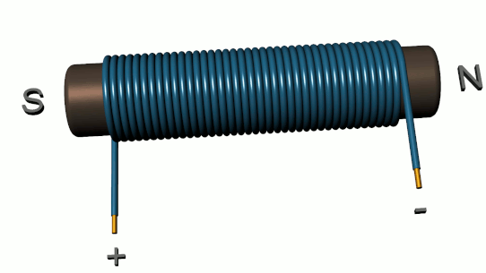
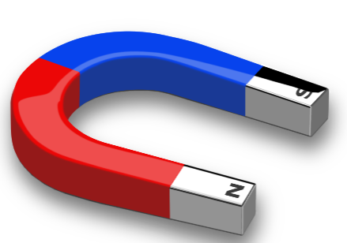





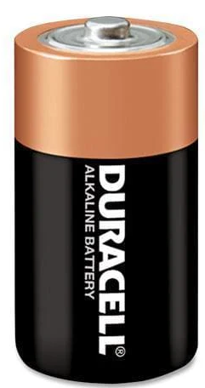
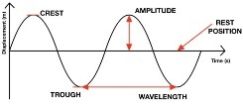
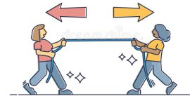


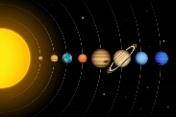



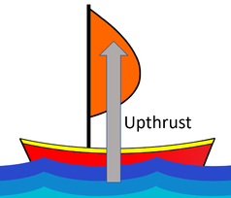
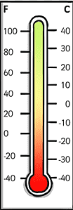
Physics Learning Journey
Year 7
Understanding and Applying Scientific Skills
Year 11
Writing methods
Assessing impact of
Understanding
IDEAL
Risk Assessment
Applying
_{Understanding} Drawing graphs and _{Analysis of} scientific concepts
relationships
Drawing Identify,
Describe and explain patterns
Exam & Post – 16 Destination
variables
analysing graphical data
secondary data
^{Modelling scientific} _{between science} conclusions describe,
maths to
concepts
and society
explain,
scientific
apply, link ^{concepts}
What id the difference between reflection and refraction?
How did the solar system form?
What is momentum?
How does momentum relate to car safety?
How do moments make our life easier?
How do we describe waves?
How do we use the EM spectrum in communications?
Why doesn’t the Moon fall to the Earth?
Space
Forces II
Waves I
Waves II
What is the difference between velocity and speed?
Forces I
Is it easier to stop a bicycle or a truck?
How do we use the wave equation?
How doe we use seismic waves to find out the structure of the Earth?
How do lenses work?
How do phone screens work?
How might the universe end?
What is terminal velocity?
What is acceleration?
What is the link between electricity and magnetism?
Why are magnets magnetic?
What is charge?
How can we sue LDRs in devices?
Do thing stay radioactive forever?
YEAR
What is Newton’s 3rd law?
Electromagnetism
11
Electricity
What is Newton’s 1st and 2nd law?
How do we make an electric motor?
How do we generate electricity?
How can we sue thermistors in devices?
What powers the Sun?
Nuclear Physics
What is resistance?
How do we calculate efficiency?
Do atoms become hot?
What is inside an atom?
What is GPE?
What is specific heat capacity?
How do we minimize energy transfer?
YEAR
10
Energy I
Energy II
Kinetic Theory
What causes pressures in gases?
Is there ‘light’ we cannot see?
What is work?
What is KE?
What is latent heat?
What is internal energy?
Why does temperature effect the volume of a gas?
How many 'colours’ are there?
How do we use electromagnetic waves?
Light
How can you make a simple speaker?
How can you make electricity move things
How do we use moments?
Pressure &
YEAR
Electromagnetism
Moments
9
What are electromagnetic waves?
How do you make a strong electromagnet?
What is a magnet?
What is air pressure?
What is water pressure?
What is the difference between current and voltage?
What is the difference between velocity and acceleration?
How can you make a series and a parallel circuit?
What is speed?
How do sound waves travel?
How do we hear sounds?
Electric Circuits
YEAR
Forces & Motion
Sound Waves
8
How do we make a circuit?
What is distance-time graph?
How do we measure speed?
What are waves?
What is sound?
What is electricity?
Why do we have day and night?
What is the difference between heat and temperature?
Can energy be stored?
What happens when forces are balanced?
What happens when forces are unbalanced?
Why do we have seasons?
Space
What is gravity?
YEAR
Energy
Core Physics
7
What objects are in the solar system?
What is the relationship between the Greenhouse effect and climate change?
How do we build green homes?
What force makes you float?
What is air resistance?
Note: In KS4 Exact teaching order within a year may vary for combined and separate students to spread practical work between groups and allow locked papers to be used effectively as exam preparation

